Slide 2
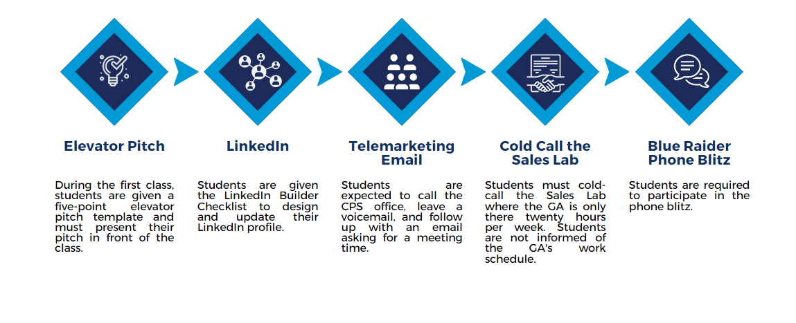
Process of
Getting the Appointment

