Slide 1


Slide 2
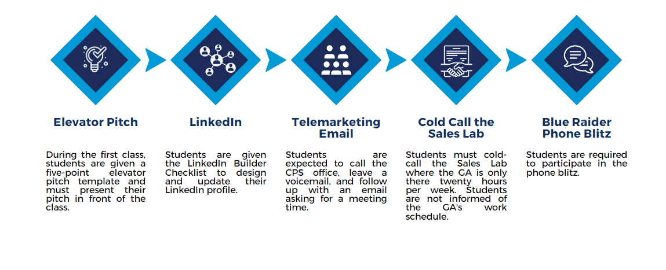
Process of
Getting the Appointment

Slide 3


Slide 4


Slide 5


Slide 6


Slide 7


