Slide 1

Helping Students Embrace ChatGPT and…
Learning How AI is Impacting the Sales Environment
Jessica Gardner
University of Minnesota Duluth

Slide 2



Agenda
Embracing where we are
Assignment Overview
Assessment
Discussion

Slide 3
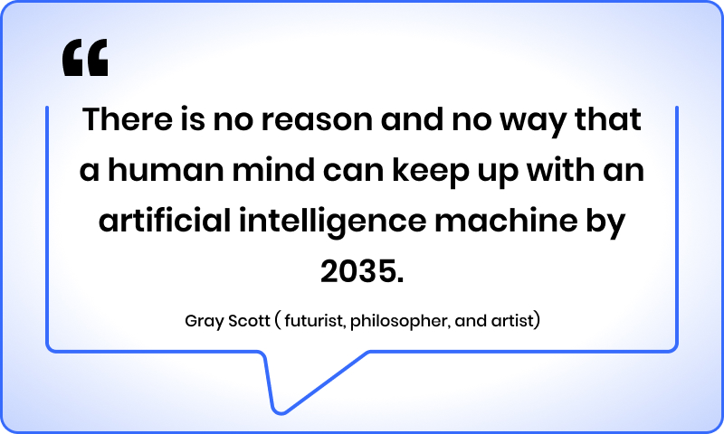
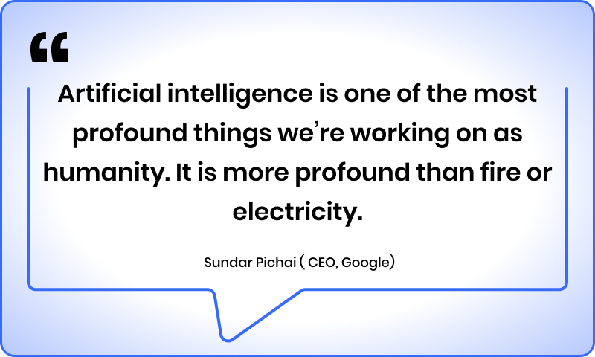
Embracing where we are
Acceptance refers to a willingness to embrace the present moment and to adapt to changes that may occur.
Resistance involves a tendency to fight against what is happening and to remain stuck in old patterns of behavior.
Which will you choose during uncertain times in the fast changing world we live in?

Slide 4
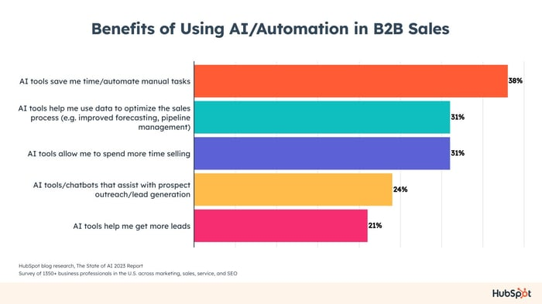

Slide 5
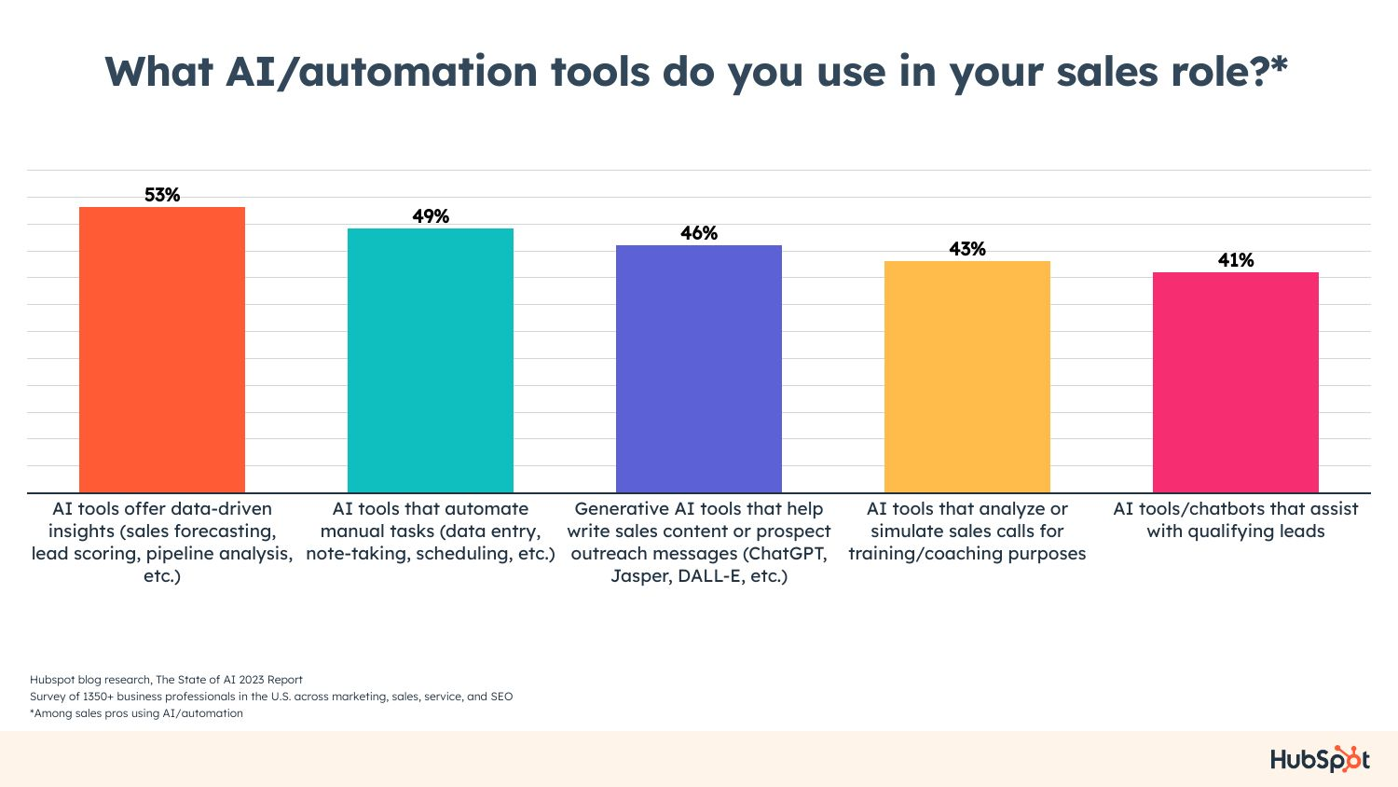
HubSpot blog research, The State of AI 2023 Report
Survey of 1350+ business professionals in the U.S. across marketing, sales, service, and SEO
HubSpot blog research, The State of AI 2023 Report
Survey of 1350+ business professionals in the U.S. across marketing, sales, service, and SEO
71% of B2B sales pros say AI/automation tools have impacted how they plan to sell in 2023.
71% of B2B sales pros say AI/automation tools have impacted how they plan to sell in 2023.
AI/Automation in B2B Sales
AI/Automation in B2B Sales

Slide 6

Helping students embrace Chat GPT
Inspire curiosity and get them to learn more about AI technologies used in sales.

Slide 7
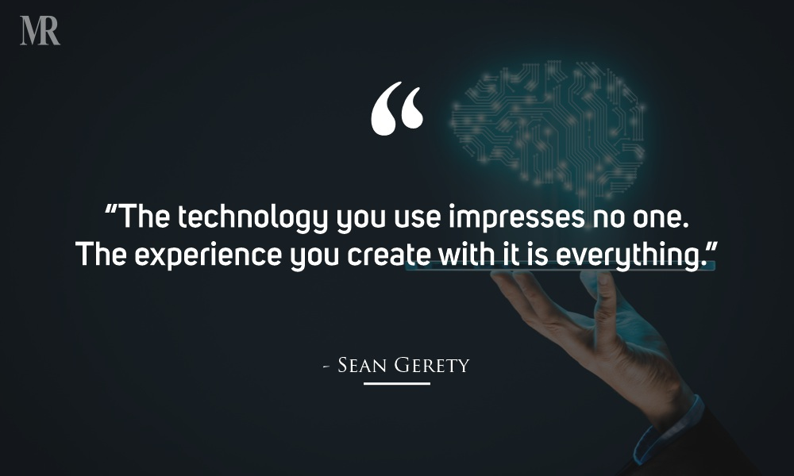

Slide 8
Introduce topic on Chat GPT
What Can it do well:
Cautions and things to avoid
Examples of uses in entry level sales roles today.
Share ideas on prompts to use to get the most relevant information.
Quick responsiveness and building off prior prompts
ability to have a genuine conversation??
Information is often outdated (Chat GPT 4 only goes up until Sept. 2021)
Use of unreliable sources or “hallucinate” incorrect information.
exhibit problematic social biases
assume disturbing personas when given an “adversarial” prompt
Too much information (but can narrow in)

Slide 9
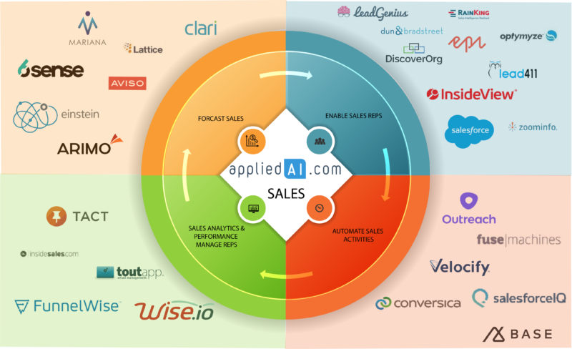
Overview of AI tools used in sales
Key areas AI is used, include:
Forecasting Sales
Enable Sales Reps
Automate Sales Activities
Sales Analytics & Performance
https://research.aimultiple.com/sales-ai/

Slide 10
Set up for assignment
Overview
Research & Presentation
By using Chat GPT, students will research and compile information on AI tools and present their findings in an engaging and informative manner.
Students will be put into groups of 4-5 to complete this assignment.
Each group will choose one specific AI tool used in sales and uncover relevant information to then present to the class (submit a request for specific tool, so no overlap between groups).
Each group should create an outline for presentation based on the guidelines given to turn in prior to creating a final presentation.

Slide 11
Assignment Learning Objectives
Learning Objective
To familiarize students with various AI tools being used in the sales environment.
To utilize Chat GPT-4 (free open AI) to gain insight and compile information on specific AI tool(s).
To understand how to use Chat GPT-4 by using prompts and asking questions to dig deeper into content.
To research further using other online resources to ensure accuracy and proper sourcing of information.
To develop an engaging and insightful presentation to share what they learned with entire class.

Slide 12
Assignment overview:
Research
Presentation Outline
Utilize Resources
Each group will focus on a different area where AI is used in sales and select one specific AI tool to focus in on.
Utilize Chat GPT-4 (free open AI) to gain insight and compile information on specific AI tool(s).
Develop an engaging and insightful presentation to share what they learned in class.
Develop an outline that contains key elements, such as:
Introduction
Key features of the AI tool
Real-world examples of its application in sales
Benefits and challenges associated with its use
Conclusion
Students should use Chat GPT to enhance their research and gather additional insights about their chosen AI tool.
Interact with Chat GPT by asking questions, seeking clarification and exploring unique perspectives oh how the AI tool is shaping the sales environment.
Save all of your prompts and responses so they can be reviewed later.
Dig in further to findings on Chat GPT to ensure accuracy, of information, secure reliable sources, and gain more updated information.
Keep track of all sources used and attempt to understand where the information in coming from.

Slide 13
Assignment overview:
Develop Presentation
Presentation / Q&A
Reflection
Use presentation software and follow outline to focus in on specific areas needed to be covered.
Create slides with support materials, such as bullet points, images, diagrams, and relevant statistics that are visually appealing and informative.
Ensure the presentation has important elements and create engaging content to keep attention of audience.
Each team should present for 20-25 minutes with 5 minutes for questions.
Keep audience engaged and involved during presentation.
Encourage critical thinking and class discussion.
Students should reflect on their interactions with Chat GPT during research process.
Discuss overall learning for this activity and viewing presentations.
Discuss advantages to using AI tools in sales and how this knowledge can benefit their future careers.
Gain feedback on how this assignment can be improved.

Slide 14
Assessment
Understanding
Demonstrate a comprehensive understanding of AI tool and its application in sales.
Presentation
Outline developed effectively. Presentation well organized and visually appealing. Conveyed key information.
Communication
Delivered confidently and engaged audience effectively. Answered questions & facilitated discussion.
Resources
Reflection
Individual feedback on assignment. Thoughtful reflections on Chat GPT interactions and impact of AI tools in sales.
Use of Chat GPT and other relevant resources to enhance research and gather relevant insights.

Slide 15

Summary
With new AI tools at our fingertips, I think we should embrace the power it offers while being caution on what it cannot. Let us think about what will become and all that is possible!

Slide 16

Discussion
How are you planning to design assignments that might use Chat GPT and other free open AI?
What concerns do you have with using assignments like this in your course?
Any ideas on major improvements to activities like this?

Slide 17


Thank You
Jessica Gardner
jjgardne@d.umn.edu
https://www.linkedin.com/in/gardnerjessica/

Slide 18
Resources:
6 innovative ways higher ed can embrace AI by Afia Tasneem and Abhilash Panthagani June 08, 2023
https://eab.com/insights/blogs/strategy/innovative-ways-higher-ed-embrace-ai/
https://www.usatoday.com/story/opinion/2023/04/07/colleges-should-embrace-chatgpt-ai-academic-potential/11569735002/
https://research.aimultiple.com/sales-ai/
https://blog.hubspot.com/sales/ai-b2b-sales

