Slide 1
How To Boost Student Engagement
Dr. Stefanie Boyer
Professor, Bryant University
Cofounder, RNMKRS
Notes:
Who holds keys to motivating students? Some of them?
How many noticed students motivation down a bit?
How many of you are feeling overwhelmed and burnt out or uninspired after a bit of covid, remote, too many new things to do and students just don’t seem easy to motivate?

Slide 2
I have a question
400%
Notes:
At what % has class time student trips to that bathroom trips gone up?
This is a made up stat.

Slide 3

Engagement Challenges
What Works
How to Engage
Leave Inspired With a Plan
Notes:
Struggles women face, why you should hire them anyway, how to support them

Slide 4

WHY EDUCATORS STRUGGLE
Notes:
Oh, yeah… educators are dealing with a lot… let’s talk about it.

Slide 5




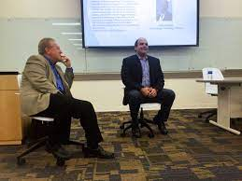

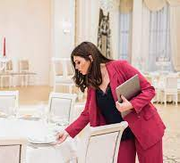
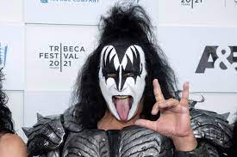
Counseling/
support
Innovator
Researcher
Customer Service
Educator
Motivational
speaker
Marketer
Event planner
Entertainer
Notes:
We have to be all of these things to all of these people and we are feeling exhausted to inspire

Slide 6
WHAT ISN’T WORKING?
Notes:
So we need to remember these things don’t work and it is a good idea to get away from them

Slide 7

LONG LECTURES
HONOR SYSTEM
“IT’S IN THE SYLLABUS” MENTALITY
KNOWLEDGE TRANSFER WITH NO SKILL DEVELOMENT
NO PRACTICE

Slide 8
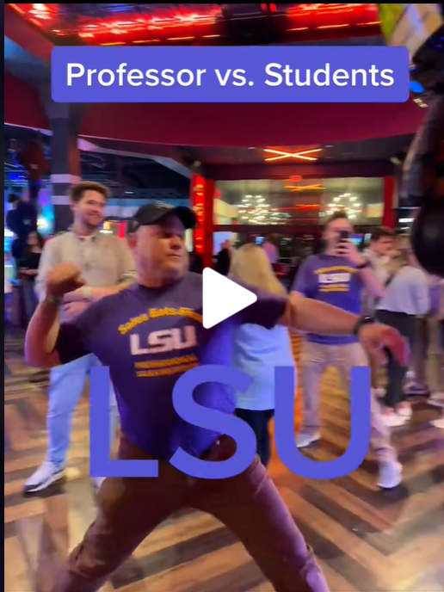
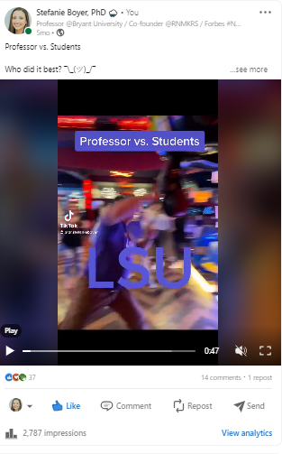
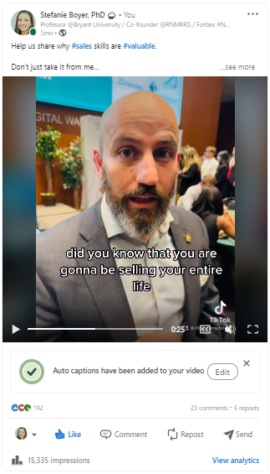

Notes:
MORE THAT DIDN’T WORK BUT I HAD FUN
TIKTOK TO ENGAGE- CONSISTENCY, LOADS OF WORK, I GOT THEM Yikes
Content worked better on LInkedIN

Slide 9

WHAT WORKS?

Slide 10
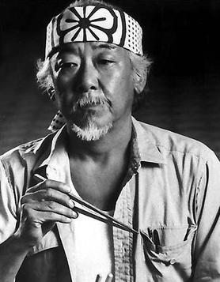
ALUMNI
STUDENT BECOMES THE TEACHER
SDL METHODS
ACCOUNTABILITY
ADAPTABILITY TRAINING
Notes:
So this morning, right? (SLEEPY, FAKE IT TO GET EXCITED FOR OTHERS AND APPRECIATE WHAT YOU DID)
FOCUS- PATTERNS: LARGE CIRCLE EASY
Get them to reset to understand – when I am in this class, I am active and learning

Slide 11


Slide 12

Notes:
AI tools can help not only inspire students, but they are great learning tools:
Quillbot can write for you in different voices for the same message
Lavender email reading and writing
In touch on LinkedIn for outreach cadence and stats
ChatGPT continues to surprise me with new abilities fun facts, reports, emails, complaint letters, resumes, tenure letters, honorary degree recipient address, social content

Slide 13
GAMIFICATION
Notes:
IMMEDIATE FEEDBACK ON LAST PERFORMANCE
LEADERBOARDS
NOTIFICATIONS
THESE DRIVE PERFORMANCE, AND GET STUDENTS TO PURPOSEFULLY PRACTICE RATHER THAN JUST GET THE NUMBERS IN

Slide 14
USING GAMIFICATION TO DELIVER AN EXCITING AND RELVENAT LEARNING EXPEREINCE
Average Number of Role Plays
Spring 2022 Role Play
Spring 2023 Role Play
Gender and Ethnicity Spring 2022 vs. Spring 2023 (pre and post gamification)
Notes:
RNMKRS offers a relevant and exciting student experience – using gamification to deliver an exciting and relevant student experience
Discuss the positive impact of diversity initiatives and the Partner School Program
Share future goals and ambitions for further enhancing diversity and partnership efforts
Huge motivation from VT and others with incentives

Slide 15
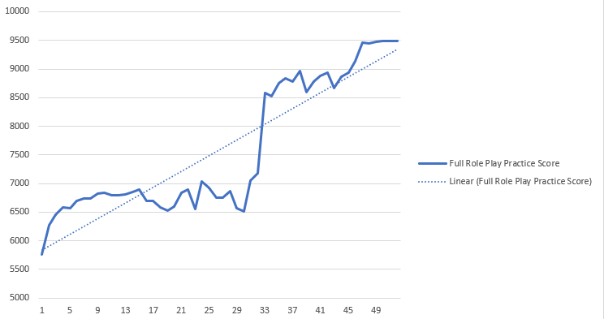
AI Sales Role Play Practice Scores – 420,000 and Counting
Proficiency in the 5-Step Sales Process
Material Improvement Starts at 30
Attempts!
Number of Full (15-minute) Role Plays
Notes:
50-50 split on gender and 25% on diverse (non white) top performers.

Slide 16

WHAT DO WE KNOW ABOUT GIVING FEEDBACK?
Notes:
How does feedback work for women?

Slide 17

GIVE IT OFTEN AND WITH EMPATHY
Notes:
Studying the impact of feedback on mental health – understand your students, listen to them, give them more autonomy to perform at their strength set. Let them flourish. If you

Slide 18

HELP FIND VOICE AND YOURS TOO
Notes:
AS MUCH AS YOU HELP STUDENTS FIND THEIR VOICE YOU NEED YOURS TOO, THEY WILL COMPLAIN AND YHOU HAVE TO HOLD THEM TO HIGH STANDARDS, WE HAVE BABIED THEM FOR TOO LONG

Slide 19

How will you engage students this semester?

Slide 20
Keep an active learning environment
Use games to engage and reset
Encourage purposeful practice
AI tools can make class more fun
You are already ahead
We’re in it together
Notes:
You’re making an impact
This is the best community – hands down

Slide 21

Notes:
You hold some of the keys to engaging your students in classes this semester and we are all here to support each other to make it happen, to help bring us all out of this funk.

Slide 22
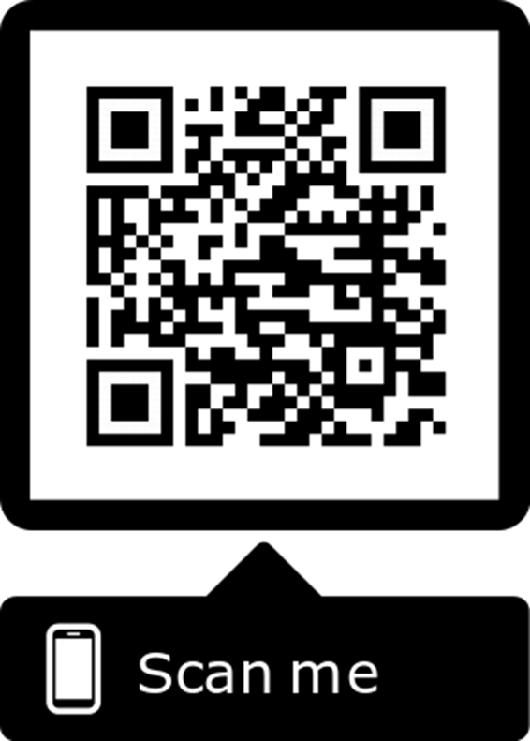

Let’s continue the conversation

Slide 23
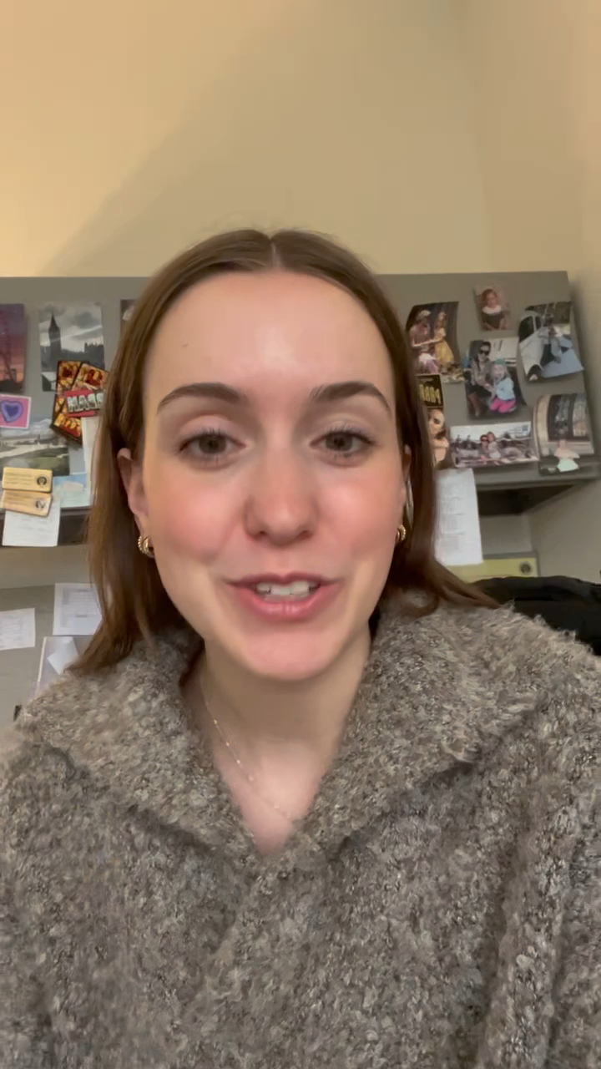
Jillian Ulicki
RNMKRS competitor
Creating a safe practice
space to drive sales
effectiveness

